Slide 1

CH 110: Btech Lab
Dr. Sunanda Chatterjee
Experiment 4
Determination of the dissociation constant of a weak acid using pH meter

Slide 2
CH 623: Supramolecular Chemistry
Dr. Sunanda Chatterjee
The aqueous solution of acetic acid dissociates as shown below
CH₃COOH + H₂O = CH₃COO⁻ + H₃O ⁺ -------------- 1
An appreciable quantity of undissociated acetic acid remains in solution.
For the general weak acid HA the dissociation reaction and the dissociation constant expression are:
HA (aqueous) + H₂O (l) = H₃O⁺ + A⁻ -------------- 2
K_{a} = [H₃O⁺] [A⁻] / [HA] -------------- 3
pH = pK_{a} - log [HA ] / [A⁻] -------------- 4
where pK_{a} = -log[K_{a}]

Slide 3
CH 623: Supramolecular Chemistry
Dr. Sunanda Chatterjee
Henderson equation
pH = pK_{a} - log [HA ] / [A⁻]
During titration of weak acid HA with a base, there will be a point when the number of equivalents of base is just one half the number of the equivalents of acid present.
This is the point at which 50% of the acid has been titrated to produce A⁻ and 50% remains as HA.

Slide 4
CH 623: Supramolecular Chemistry
Dr. Sunanda Chatterjee
At this point, known as half - equivalence point,
[HA] === [A⁻]
then, pH === pK_{a}. ----------------5
By titrating a weak acid with a strong base and recording the pH versus
the volume of base added the dissociation constant of the weak acid can be obtained.

Slide 5
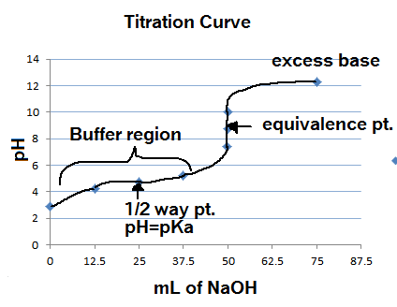
CH 623: Supramolecular Chemistry
Dr. Sunanda Chatterjee
Upon titrating a weak acid by strong base, after a certain volume of base addition, the pH of the solution changes suddenly.
This point is the equivalence point of titration.
From the equivalence point determination, half equivalence point can be deduced
pH = pKa of the weak acid at the half equivalence point
By titrating a weak acid with a strong base and recording the pH versus the volume of base added the dissociation constant of the weak acid can be obtained.

Slide 6
CH 623: Supramolecular Chemistry
Dr. Sunanda Chatterjee
Materials and Apparatus
pH meter
Burrete (50 ML)
Plastic Beaker (100mL, 2 Nos.)
Pipette (20 ml)
Pipette pump 1 no
Acetic acid (unknown strength)
NaOH (0.1 N)

Slide 7
CH 623: Supramolecular Chemistry
Dr. Sunanda Chatterjee
Standardize the pH meter by using the supplied buffer solution.
Place 20 ml of supplied acetic acid solution in a 100 ml beaker. Measure pH of the solution by dipping the calomel and the glass electrode into it.
Fill up the burette with 0.1 NaOH solution. Carry out the titration by adding 1 ml portions of NaOH solution to the acid solution. Stirr it thoroughly and note down the pH value after each addition.
Note the volume of NaOH required for a sharp change in pH. This is the neutralisation point. After the neutralization point add 2 ml portions of NaOH at least for 8 readings and note the pH after each addition.

Slide 8
CH 623: Supramolecular Chemistry
Dr. Sunanda Chatterjee
Plot pH versus volume of NaOH to find out the approximate volume of NaOH required for neutralisation.
Repeat step 2 to 4. This time add NaOH solution in 2 ml portions till the volume of NaOH solution added is 2 ml less than required to reach the neutralisation point. Then add 0.5 ml portions of NaOH so that the sharp change in pH could be noted.
Plot pH versus volume of NaOH. Determine the neutralisation point from the curve and the pH of the solution at half - neutralisation point.
This pH value corresponds to the pK_{a} of the acid. Calculate the dissociation constant.

Slide 9
CH 623: Supramolecular Chemistry
Observation
Dr. Sunanda Chatterjee
Titration No | Table 1 |  | Table2
 | Vol. of NaOH(mL) | pH observed | Vol. of NaOH(mL) | pH observed
1
2
3
4
5
6
7
8
9
10
11

